Slide 1
FLOW MATCHING FOR GENERATIVE MODELING
Gwangwoo Kim
20240605

Slide 2
Deep generative models
(Restricted or Deep) Boltzmann Machine
Autoregressive Model
Energy-based Model
Variational Autoencoder
Generative Adversarial Network
Flow-based Generative Model
Diffusion-based Generative Model

Slide 3
Deep generative models
(Restricted or Deep) Boltzmann Machine
Autoregressive Model
Energy-based Model
Variational Autoencoder
Generative Adversarial Network
Flow-based Generative Model
Diffusion-based Generative Model
Very long training time
Inefficient sampling

Slide 4
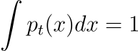
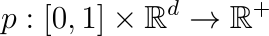
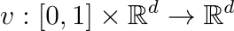
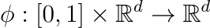
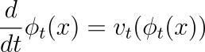
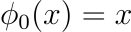
Continuous Normalizing Flows
Definitions
Let be a data point
Probability density path with
Time-dependent vector field
Time-dependent diffeomorphic map (or flow)
It defined via the ODE
If the vector field is parametrized, the model is called a Continuous Normalizing Flow (CNF).

Slide 5
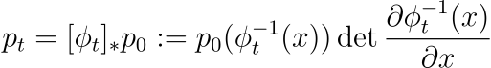
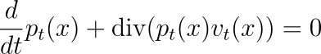
Continuous Normalizing Flows
Remarks
A CNF reshapes a density to :
is said to generate if its flow satisfies the above equation
One way to check this is to verify the continuity equation

Slide 6
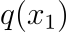
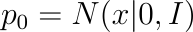
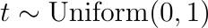
Flow Matching
Setting
Let be a sample from (unknown) data distribution
Put be a (target) probability density path such that
Given and a corresponding vector field , we define

Slide 7
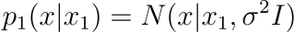
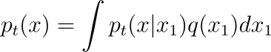
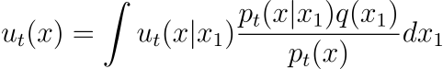
Conditional Probability Path
Goal: Construct and
Introduce a conditional probability path such that
The marginal probability path:
Define a marginal vector field:

Slide 8
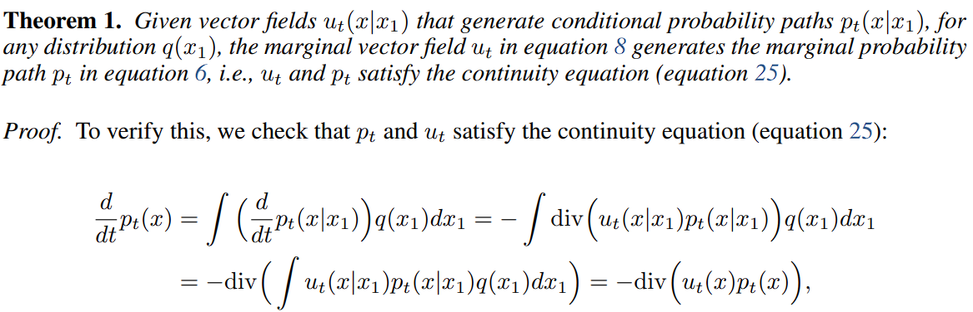
Conditional Probability Path

Slide 9
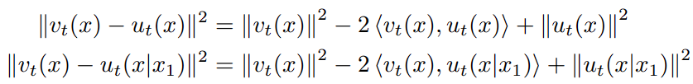
Conditional Flow Matching
Consider the Conditional Flow Matching objective
(sketch of the proof)

Slide 10
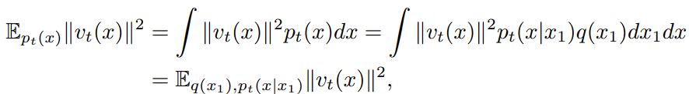
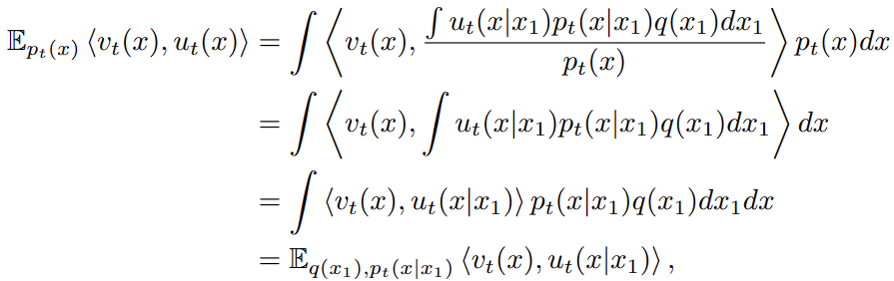
Conditional Flow Matching

Slide 11
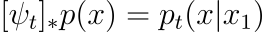
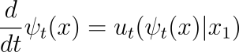
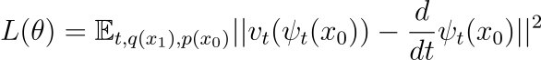
Construction of CPPs and VFs
Example (Gaussian conditional probability paths)
Here,
Consider the flow conditioned on
Then it is easily shown that
Moreover, since (definition of flow)

Slide 12
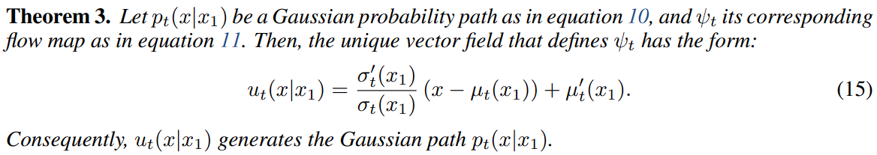
Construction of CPPs and VFs

Slide 13
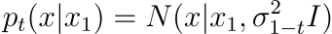
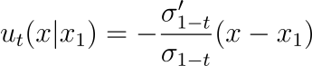
Examples
Variance Exploding path (or SMLD)
Here is an increasing function with .
In this case, and Theorem 3 provides

Slide 14
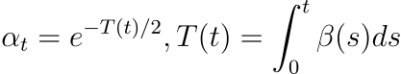
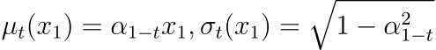
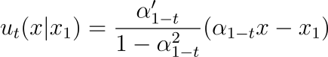
Examples
Variance Preserving path (or DDPM)
In this case, and Theorem 3 provides

Slide 15
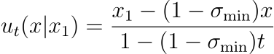
Examples
Optimal Transport conditional VFs
There is a simple choice for them:
Theorem 3 gives
The corresponding conditional flow is
The CFM loss will now be

Slide 16
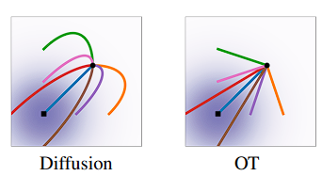
Why optimal?

Slide 17
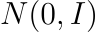
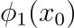
Sampling strategy
(Step 1) Sample from
(Step 2) Compute by solving (ODE solver)

Slide 18
Sampling strategy
(Step 1) Sample from
(Step 2) Compute by solving (ODE solver)
On the other hand, diffusion-based models can be sampled through an SDE formulation.
There are more efficient sampling methods for the diffusion models, e.g., Denoising diffusion implicit models (2020) or Fast sampling of diffusion models with exponential integrator (2022)
They utilize an ODE solver

Slide 19
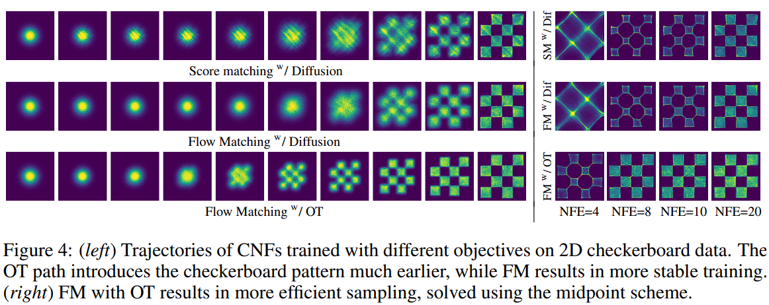
Experiment

Slide 20
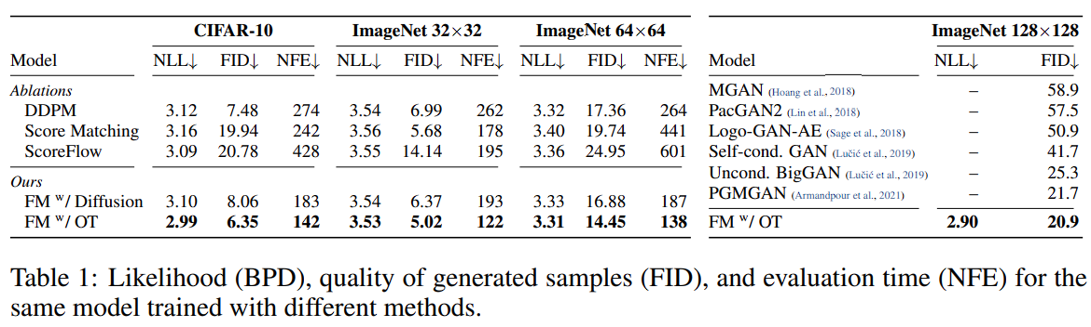
Experiment

Slide 21
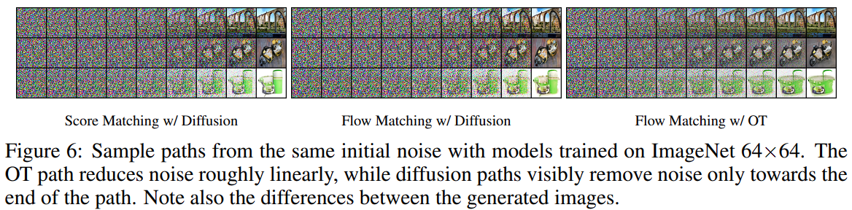
Experiment

Slide 22
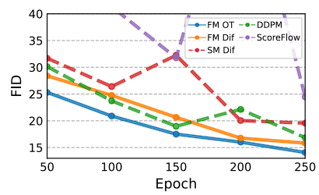
Experiment

Slide 23
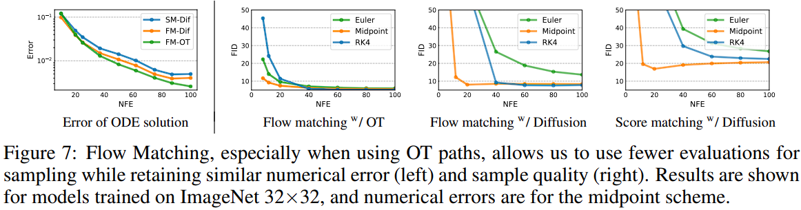
Experiment

Slide 24
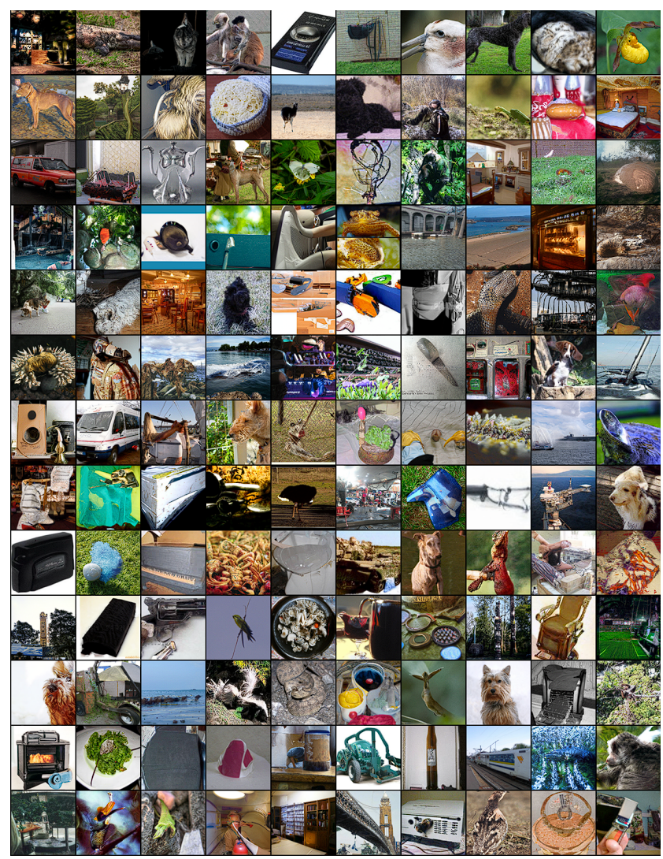
Experiment

Slide 25
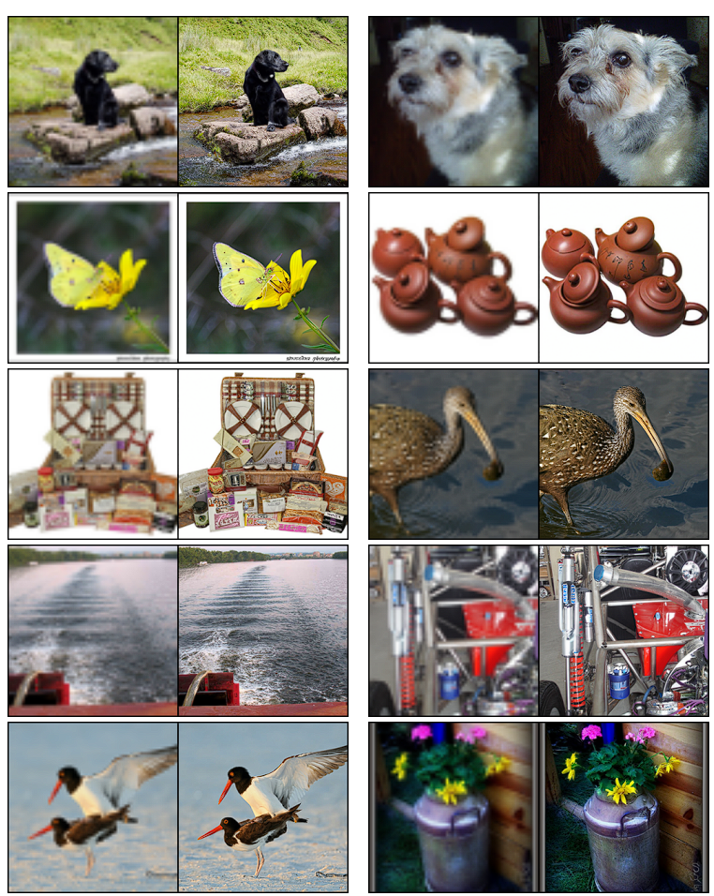
Experiment

Slide 26
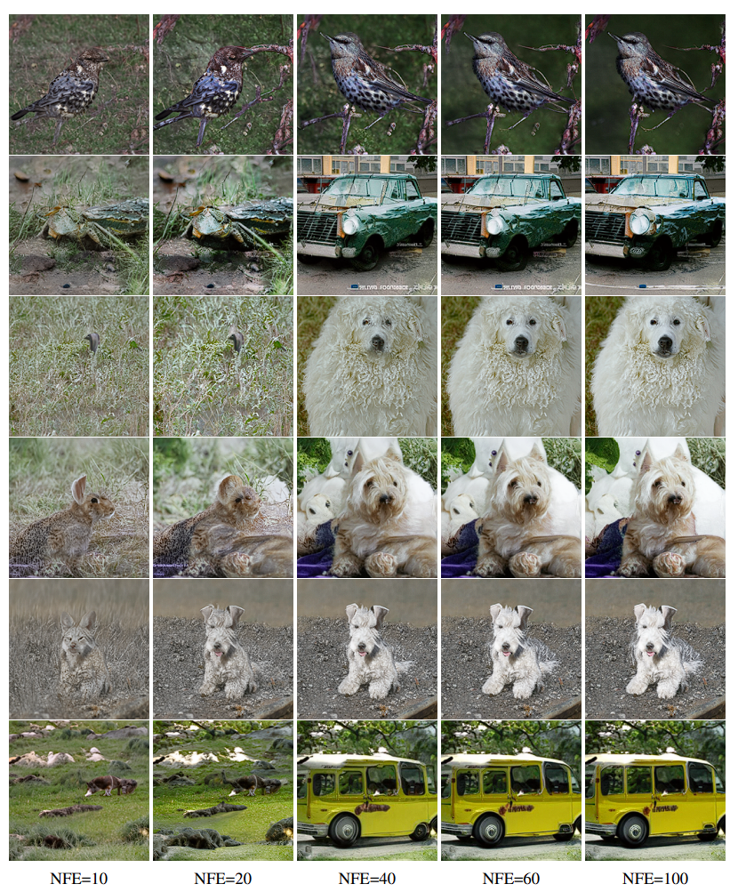
Experiment

Slide 27
Reviewer AKwV (score 5)
Weaknesses
Peluchetti, Stefano. "Non-Denoising Forward-Time Diffusions." (2021).
I'm 99% sure that this is caused by using the wrong downsampled ImageNet dataset.

Slide 28
Reviewer tWC7 (score 8)
Weaknesses
The reason for introducing sigma_min is not stated explicitly.
I would therefore expect the implementation of the diffusion baseline to be treated with due care.

Slide 29
Reviewer LJky (score 8)
Weaknesses
FID metrics are much higher than that reported in [2] (see Table 5, for ImageNet 64x64). Can the authors comment on this?
[2] Dhariwal, P. and Nichol, A., 2021. Diffusion models beat gans on image synthesis. Advances in Neural Information Processing Systems, 34, pp.8780-8794.

Slide 30
Reviewer SQzg (score 10)
This contribution is valuable and should be highlighted at the conference. (ICLR 2023)

Slide 31
References
Lipman, Y., Chen, R. T., Ben-Hamu, H., Nickel, M., & Le, M. (2022). Flow matching for generative modeling. arXiv preprint arXiv:2210.02747.
Robert J McCann. A convexity principle for interacting gases. Advances in mathematics, 128(1): 153–179, 1997.

